Slide 1
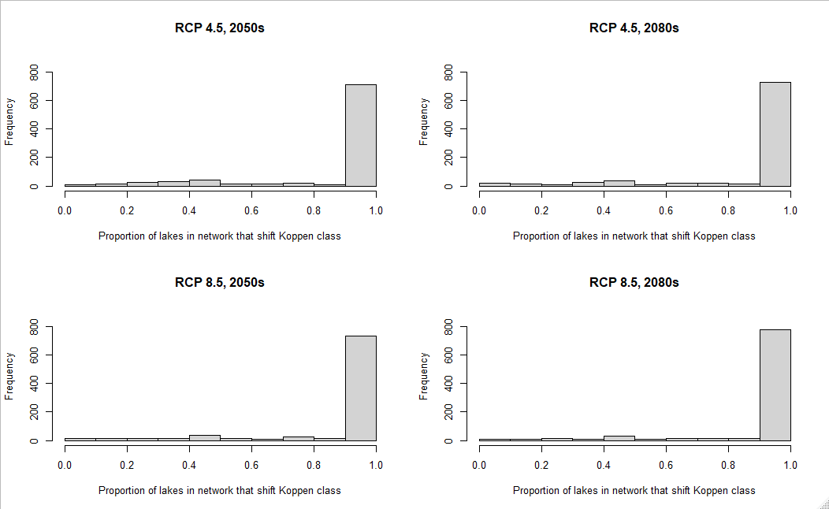
Most networks have most lakes shifting climate, but few networks relatively stable
Shifted climate within network
Stable climate within network

Slide 2
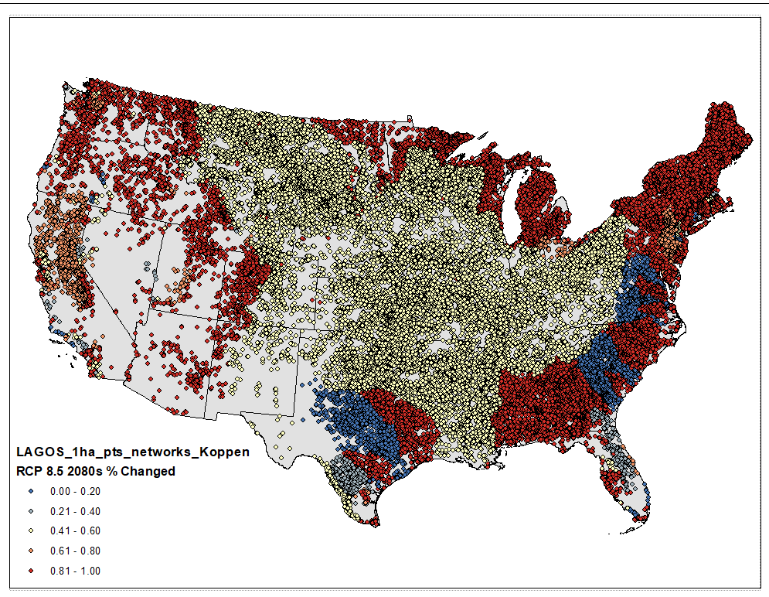
Proportion of lakes in each network that shifted Koppen climate class from 1981-2010 to 2071-2100 under RCP 8.5 (business as usual emissions)

Slide 3
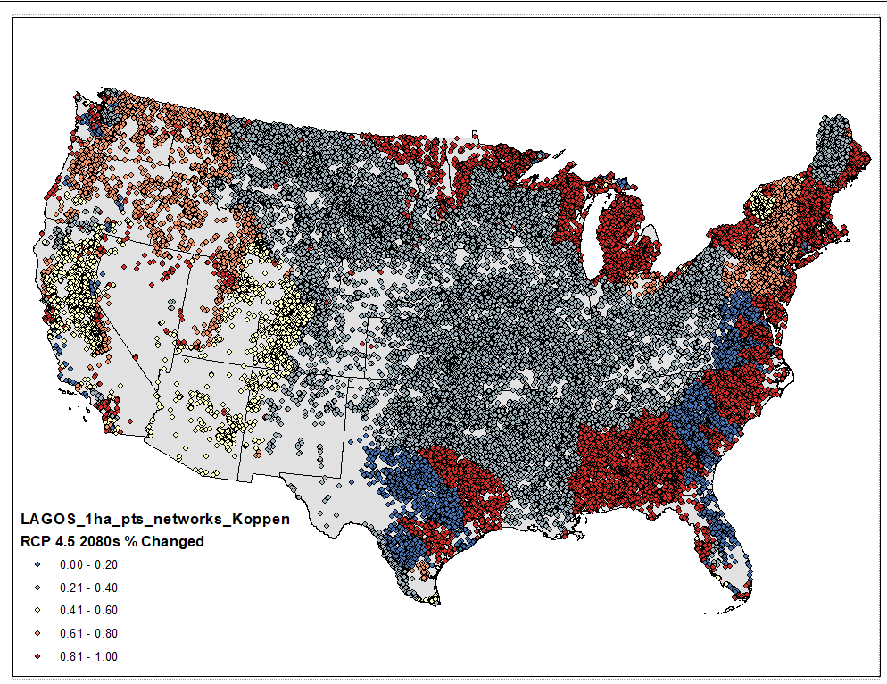
Proportion of lakes in each network that shifted Koppen climate class from 1981-2010 to 2071-2100 under RCP 4.5 (mitigated emissions)

Slide 4
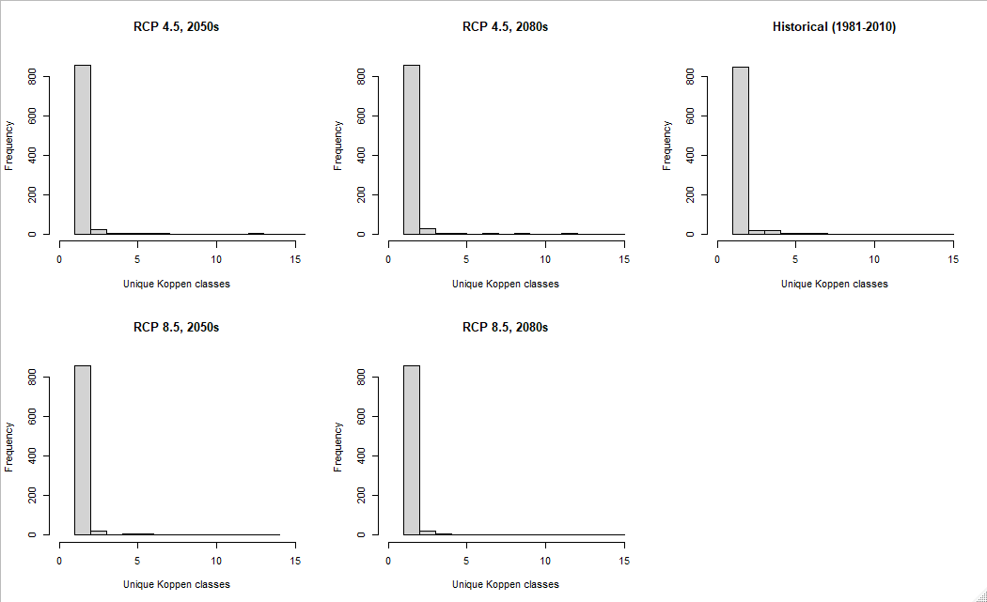
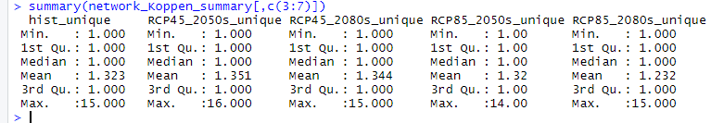
Perhaps slight loss of climatic diversity within networks, but most networks have low climatic diversity

Slide 5
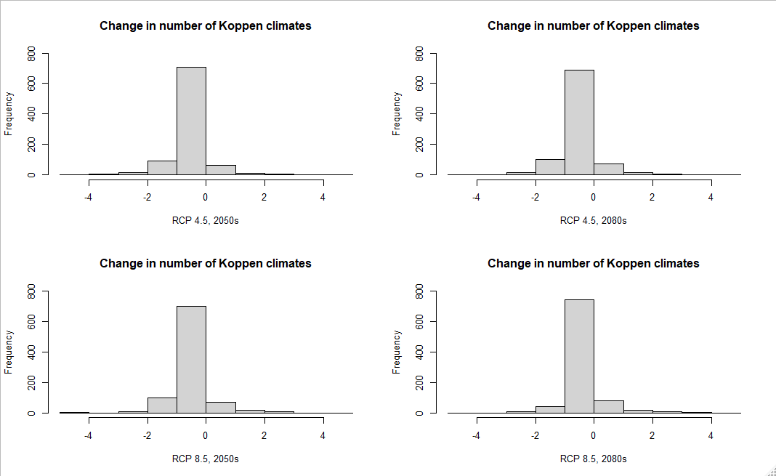
Most networks lost one climate class

Slide 6
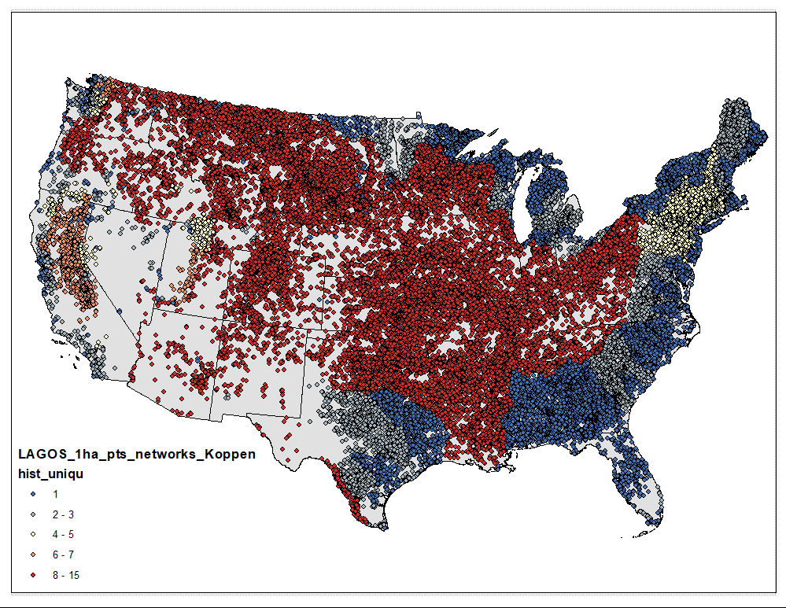
Number of unique Koppen climates in each network for historical period (1981-2010)

Slide 7

Number of unique Koppen climates in each network for RCP 8.5 2071-2100 (business as usual emissions)

Slide 8

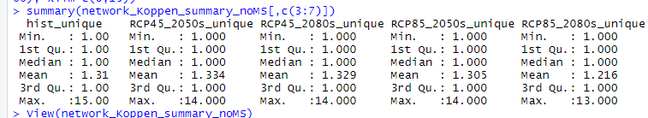
If remove MS river basin
Networks 2, 34, 52 highly diverse climatically

Slide 9
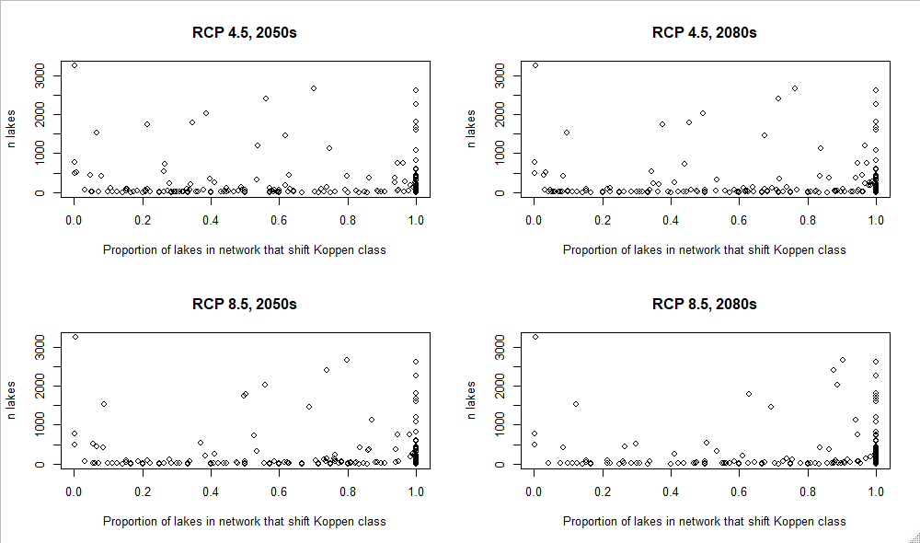
If remove MS river basin
Do networks with more lakes have more/less stable climate?

Slide 10
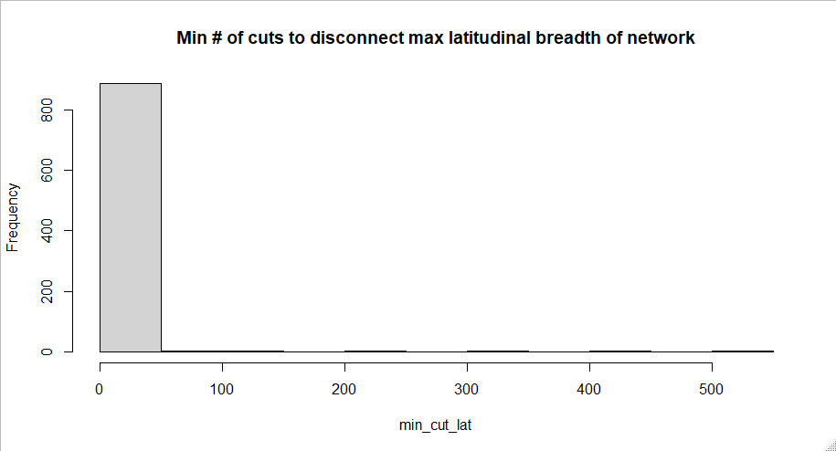
summary(networks_geo$min_cut_lat)
Min. 1st Qu. Median Mean 3rd Qu. Max. NA's
1.000 1.000 1.000 4.404 1.000 550.000 1

Slide 11
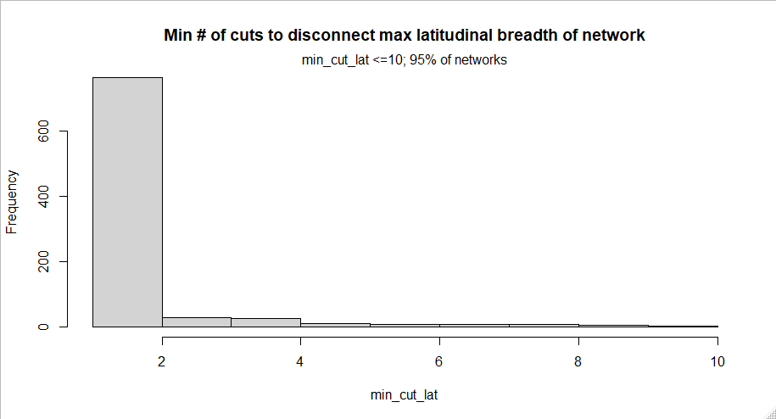
summary(networks_geo_min10_cut_lat$min_cut_lat)
Min. 1st Qu. Median Mean 3rd Qu. Max.
1.000 1.000 1.000 1.486 1.000 10.000

Slide 12
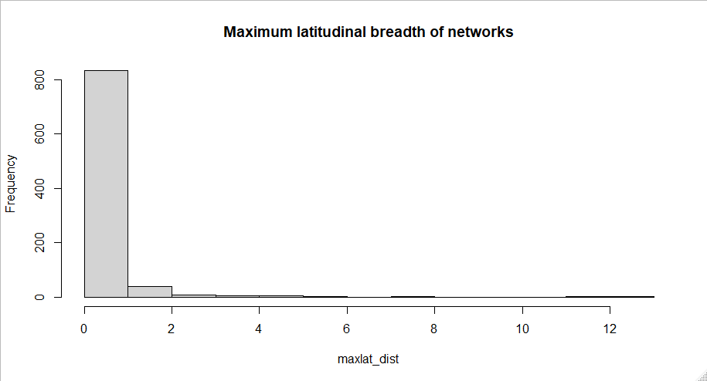
summary(networks_geo$maxlat_dist)
Min. 1st Qu. Median Mean 3rd Qu. Max. NA's
0.000031 0.015111 0.053374 0.289492 0.183529 12.031244 1
Outside the tropics, average annual temperature declines on average 0.7°C for each degree of latitude in the Northern Hemisphere and on average 0.5°C for each degree of latitude in the Southern Hemisphere. With one degree of latitude equal to approximately 111 km, this translates to a decline of 1°C for every 150 km in the Northern Hemisphere and a decline of 1°C for every 197 km in the Southern Hemisphere.
La Sorte et al. (2014); https://www.ncbi.nlm.nih.gov/pmc/articles/PMC4031198/

Slide 13
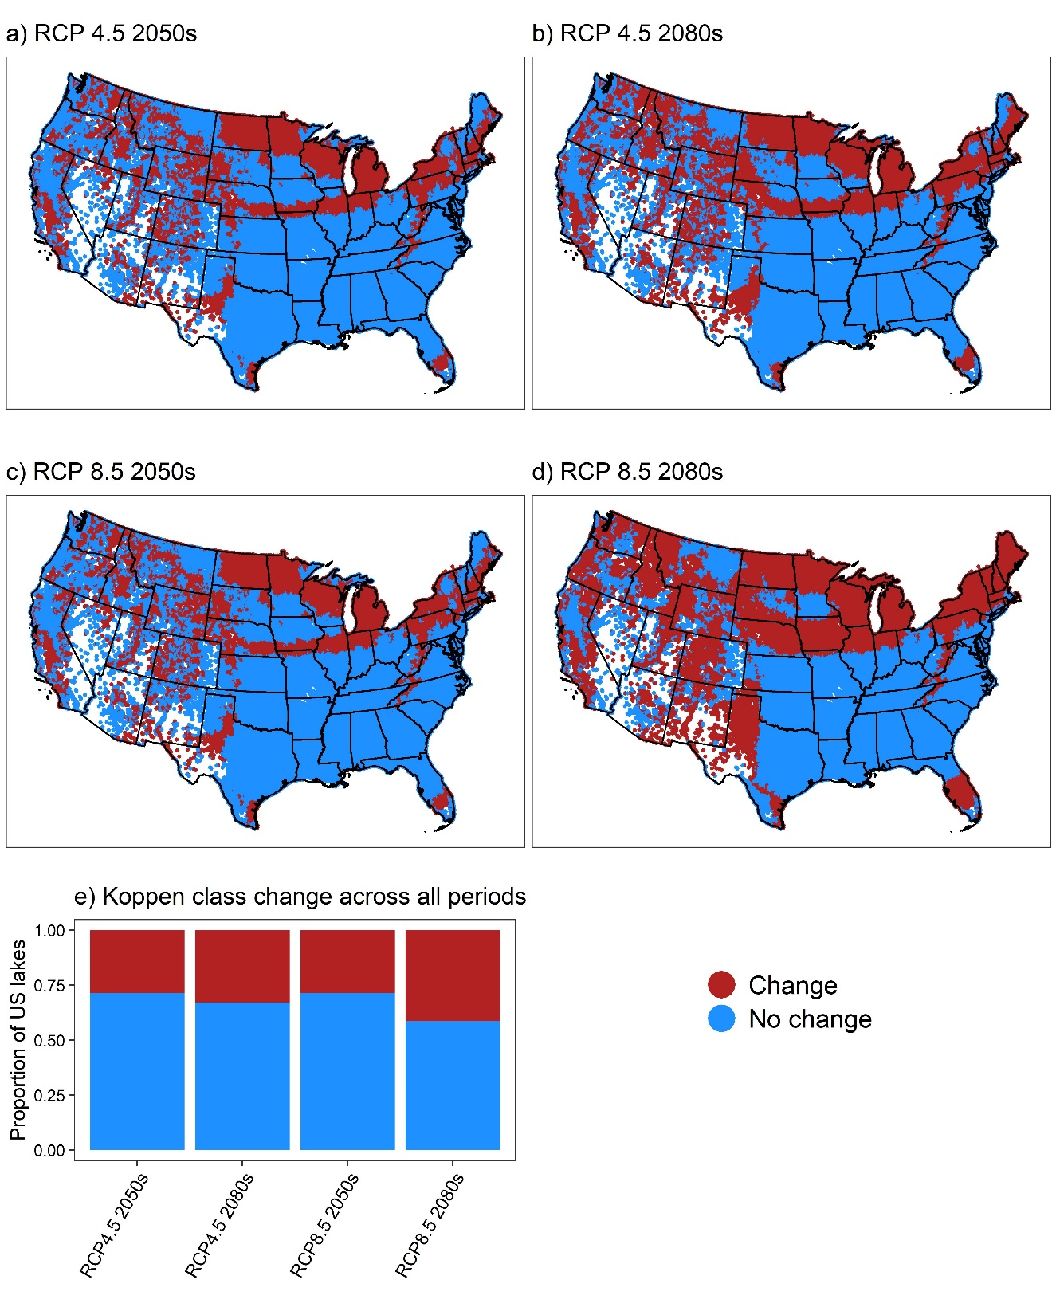
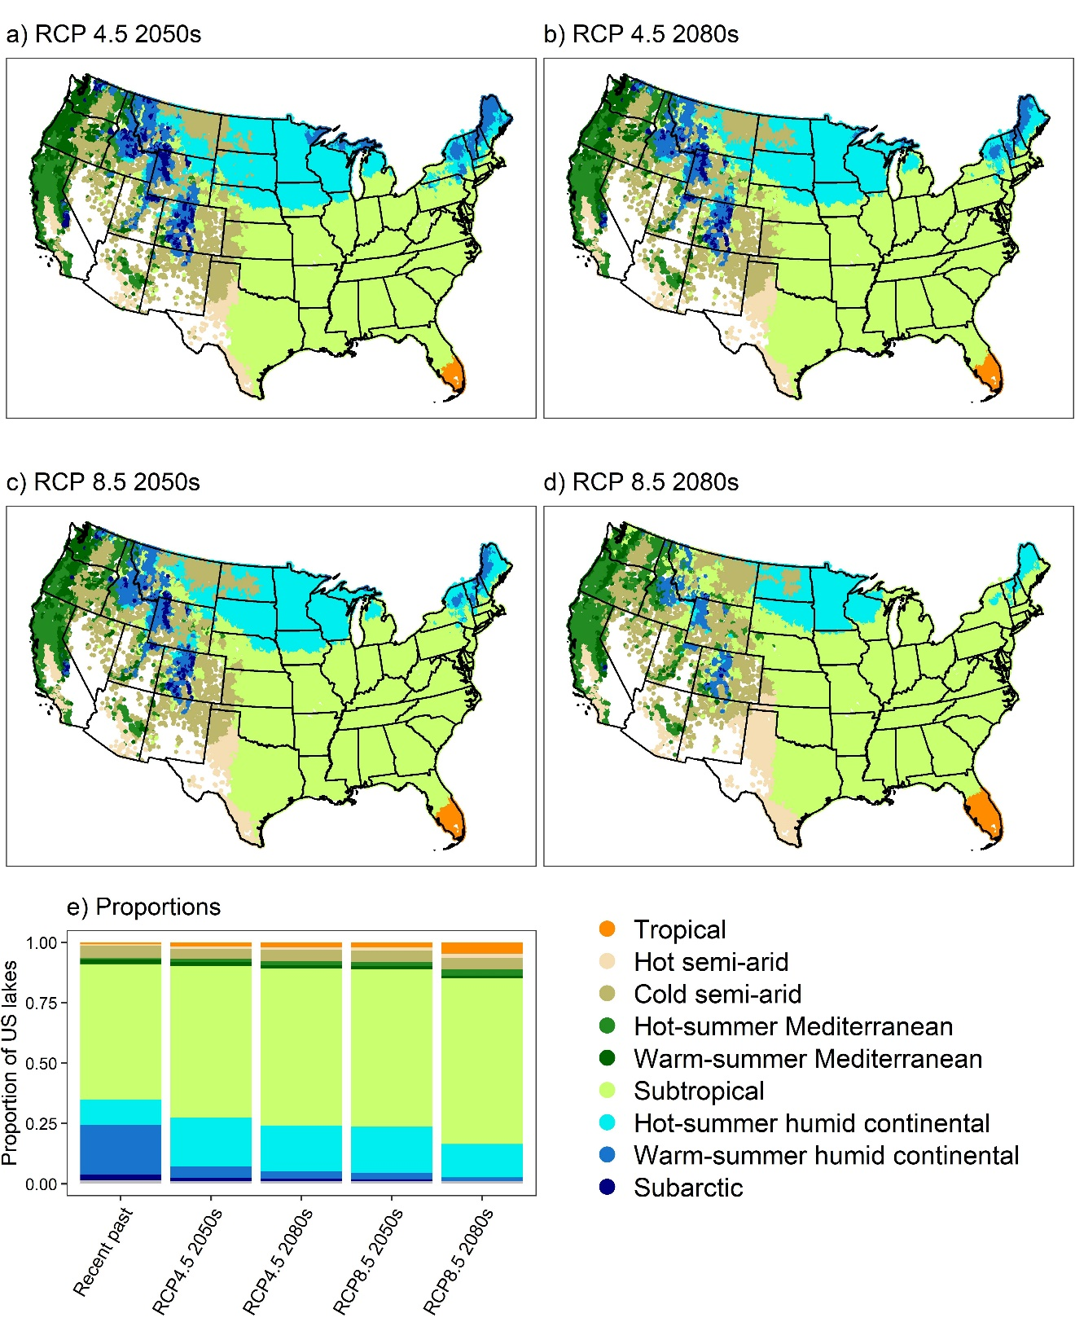

Slide 14
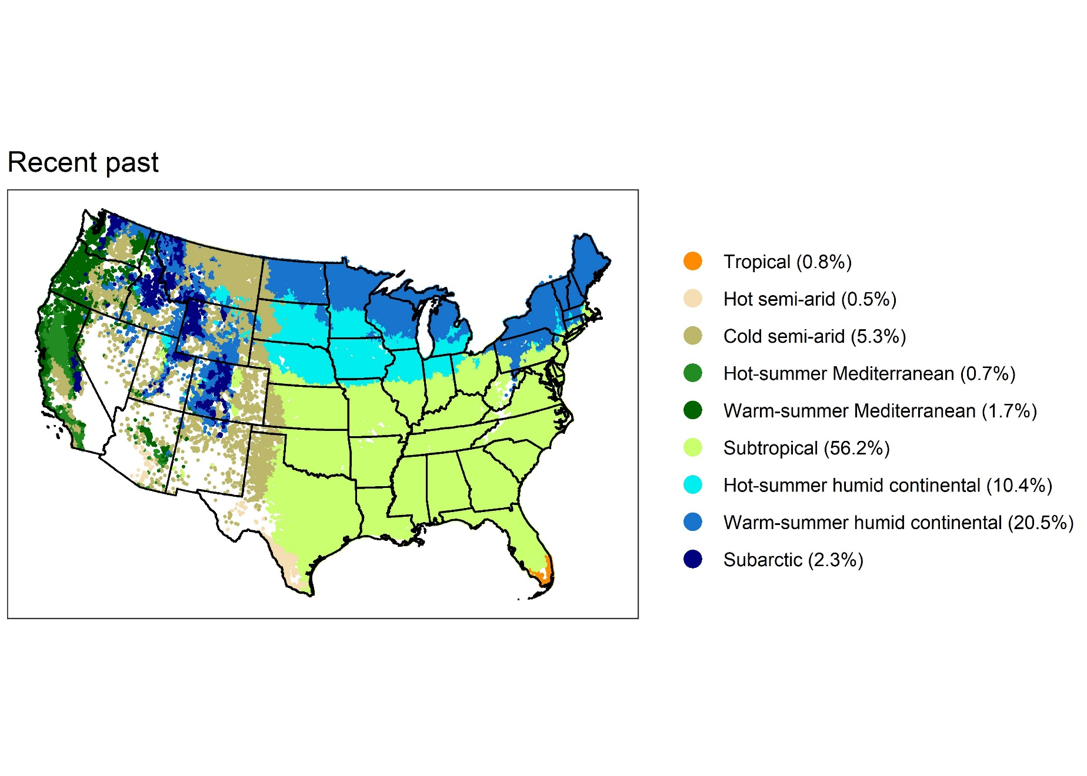

Slide 15
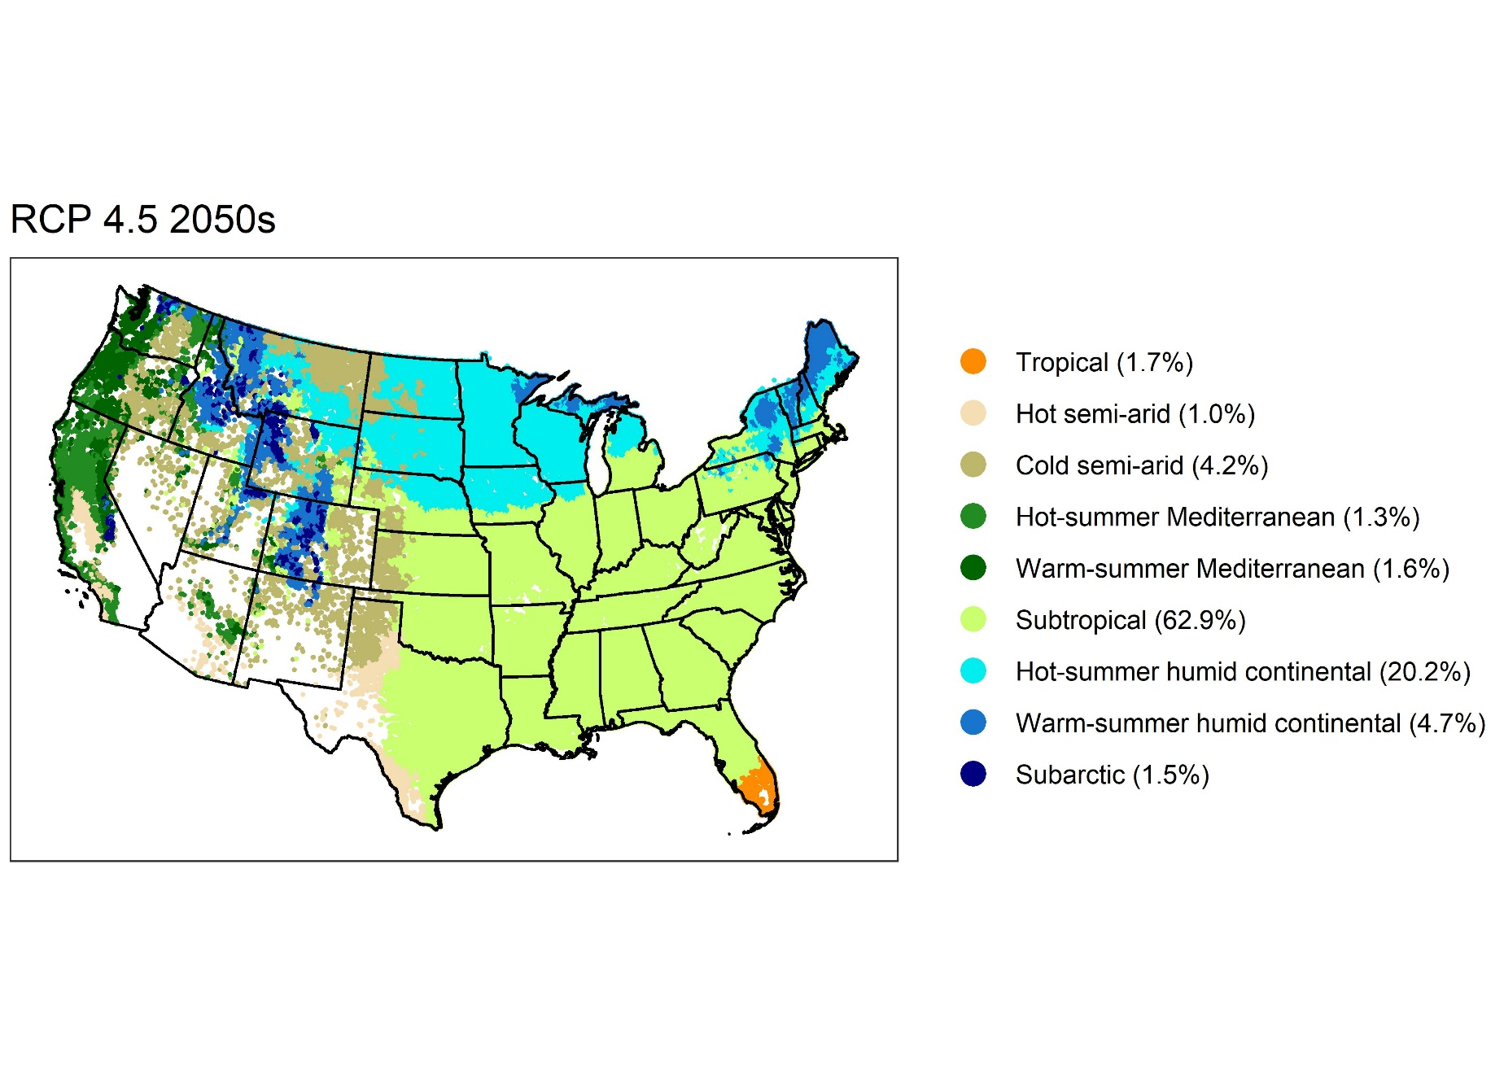

Slide 16
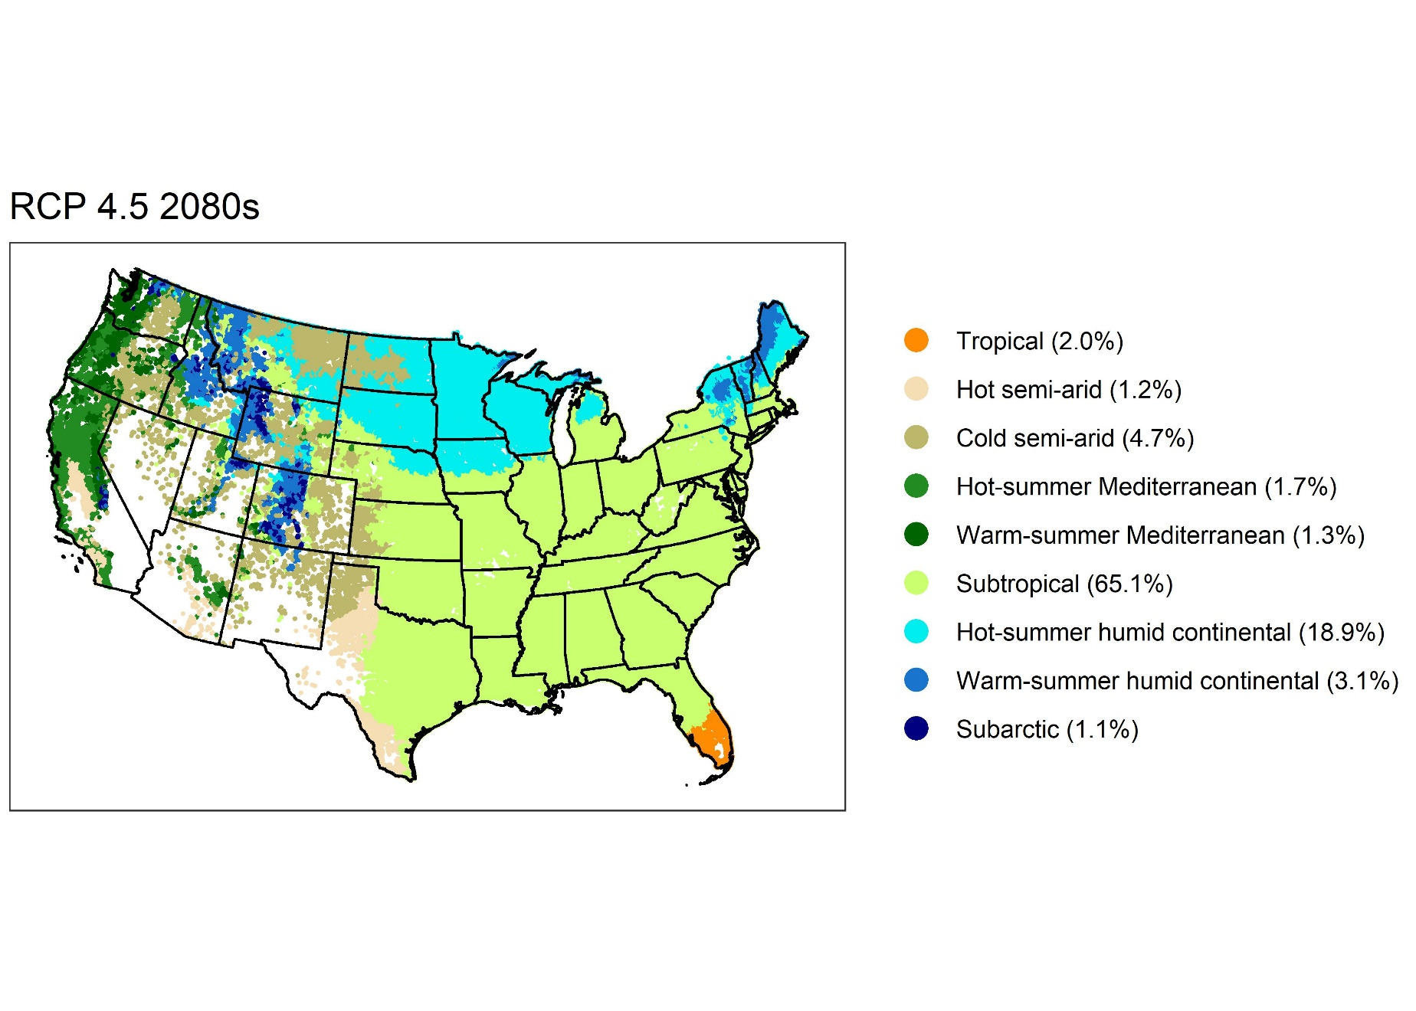

Slide 17


Slide 18
